Slide 1
IT5302 SOFTWARE ENGINEERING

Slide 2
Class Based Modeling
Class based modeling represents the objects that the system will manipulate, the operations that will be applied to the objects to effect the manipulation, relationships between the objects and the collaborations that occur between the classes are defined.
The elements of class based model include
Classes and objects
Attributes
Operations
class-responsibility-collaborator (CRC) models
Collaboration diagrams
Packages.

Slide 3
Identifying Analysis Classes
There is a set of physical objects that can be easily identified, classified and defined.
But, the problem space of a software application, the classes may be more difficult to comprehend.
Identify classes by examining the usage scenarios developed as part of the requirements model and performing a ‘grammatical parse’ on the use cases developed for the system to be built.
Classes are determined by underlining each noun or noun phrase and entering into a simple table.
Synonyms should be noted.

Slide 4
If the class is required to implement a solution, then it is part of the solution space.
Otherwise, if a class is necessary only to describe a solution, it is part of the problem space.
Analysis classes manifest themselves in one of the following ways:
External entities
Things
Occurrences or events
Roles
Organizational units
Places
Structures

Slide 5
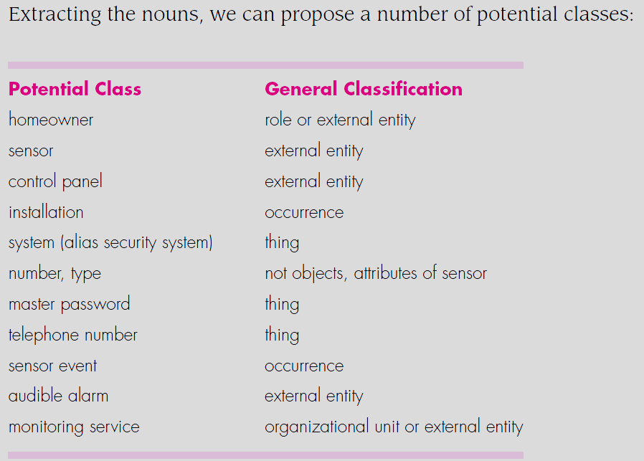
Consider a grammatical parse for a processing narrative for the SafeHome security function. The list would be continued until all nouns in the processing narrative have been considered.

Slide 6
Coad and Yourdon suggest six selection characteristics that should be used as you consider each potential class for inclusion in the analysis model:
Retained information
Needed services
Multiple attributes
Common attributes
Common operations
Essential requirements

Slide 7
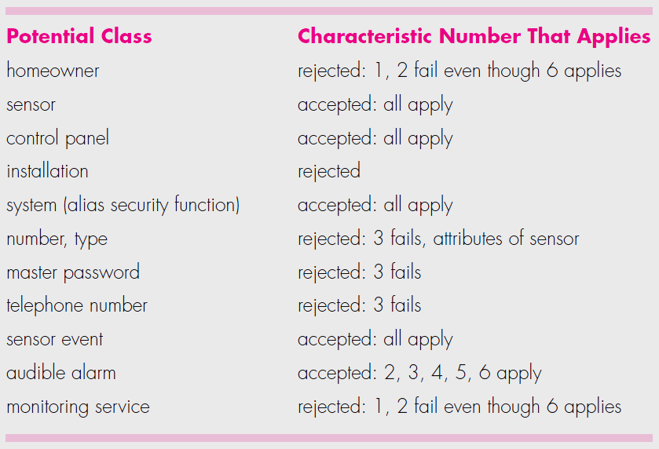
The first step of class-based modeling is the definition of classes and decisions must be made.
You should apply the selection characteristics to the list of potential SafeHome classes:

Slide 8
It should be noted that
The preceding list is not all-inclusive, additional classes would have to be added to complete the model.
Some of the rejected potential classes will become attributes for those classes that were accepted.
Different statements of the problem might cause different “accept or reject” decisions to be made.

Slide 9
Specifying attributes
Attributes describe a class that has been selected for inclusion in the requirements model.
It is the attributes that define the class- that clarify what is meant by the class in the context of the problem space.
To develop a meaningful set of attributes for an analysis class, you should study each use case and select those “things” that reasonably “belong” to the class.

Slide 10
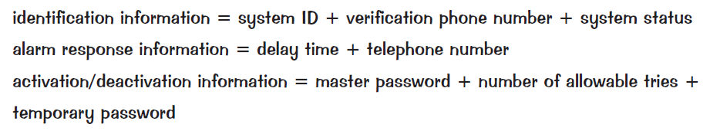
Consider the system class defined for SafeHome.
Composite data items:

Slide 11
Defining Operations
Operations define the behavior of an object.
Divided into four broad categories:
Operations that manipulate data in some way (adding, deleting, reformatting, selecting)
Operations that perform a computation
Operations that inquire about the state of an object
Operations that monitor an object for the occurrence of a controlling event.
Therefore, operations must have ‘knowledge’ of the nature of the class’ attributes and associations.

Slide 12
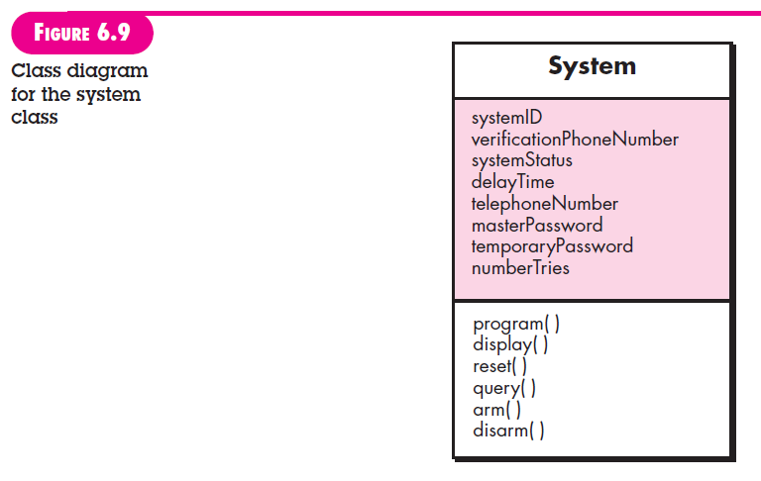

Slide 13
Class-Responsibility –Collaborator (CRC) modeling
CRC modeling provides a simple means for identifying and organizing the classes that are relevant to system or product requirements.
The intent is to develop an organized representation of classes.
Responsibilities are the attributes and operations that are relevant for the class.
Simply, Responsibility is “anything the class knows or does”.
Collaborators are those classes that are required to provide a class with the information needed to complete a responsibility.
Collaboration implies either a request for information or a request for some action.

Slide 14
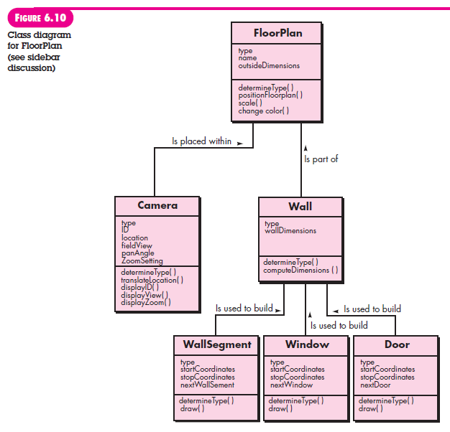

Slide 15
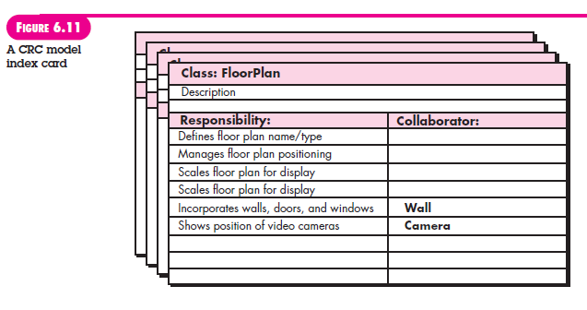

Slide 16
Classes
Entity class-extracted directly from the statement of the problem.
Boundary classes- used to create the interface that the user sees and interacts.
Controller classes- manage a “unit of work” from start to finish. (not considered until the design activity has begun)

Slide 17
Responsibilities
Five guidelines for allocating responsibilities to classes:
System intelligence should be distributed across classes to best address the needs of the problem.
Each responsibility should be stated as generally as possible.
Information and the behavior related to it should reside within the same class.
Information about one thing should be localized with a single class, not distributed across multiple classes.
Responsibilities should be shared among related classes, when appropriate.

Slide 18
Collaborations
Classes fulfill their responsibilities in one or two ways:
A class can use its own operations to manipulate its own attributes, thereby fulfilling a particular responsibility or
A class can collaborate with other classes.
Collaborations are identified by determining whether a class can fulfill each responsibility itself.
If it cannot, then it needs to interact with another class. Hence a collaboration.

Slide 19
Associations and Dependencies
In many instances, two analysis classes are related to one another in some fashion, much like two data objects may be related to one another. In UML these relationships are called associations.
In some case, an association may be further defined by indicating Multiplicity.
In many instances, a client-server relationship exists between two analysis classes. In such cases, a client class depends on the server class in some way and a dependency relationship is established.

Slide 20
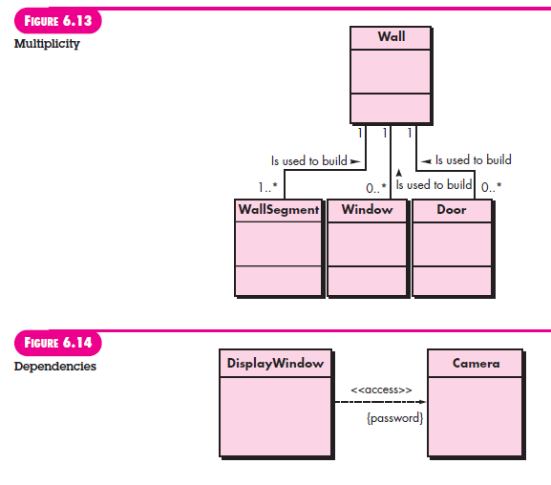

Slide 21
Analysis Packages
An important part of analysis modeling is categorization.
Various elements of analysis model are categorized in a manner that packages them as a grouping, called an analysis package.
Plus sign- public visibility
Minus sign-element is hidden from all other packages
# sign- element is accessible only to packages contained within a given package.

Slide 22
